Slide 1


Pickens High School Dual Enrollment Information Guide 2020-21
This guide is intended to only give a general overview of the different opportunities within the Dual Enrollment program. Pickens High School follows the guidelines and regulations set forth by the Georgia Department of Education, Georgia Student Finance Commission and participating post-secondary institutions, all of which are subject to change without notice to Pickens High School.

Slide 2

Dual Enrollment 2020-21
We will discuss:
Conventional Graduation Requirements
Honors classes
Advanced Placement (AP) classes
The different categories of the Dual Enrollment Program
Dual Enrollment “Option A” Academics
Dual Enrollment “Option A” Technical Programs
Dual Enrollment “Option B” Alternative Graduation Plan

Slide 3
Dual Enrollment 2020-21
Conventional Graduation Requirements
Every student at Pickens High School, excluding those in special programs, is required to accumulate 28 credits, including required and elective classes, in order to be eligible for graduation. The required credits for transfer students will be determined at the time of enrollment.
English - 4 Credits Required Including: | Math - 4 Credits Required Including: | Science - 4 Credits Required Including: | Social Studies - 4 Credits Required Including:
1 Credit: 9th Grade Literature and Composition | 1 Credit: Algebra I (EOC) | 1 Credit: Physical Science or Physics | 1 Credit: American Government/Civics
1 Credit: of World Literature and Composition | 1 Credit: Geometry | 1 Credit: Biology (EOC) | 1 Credit: World History
1 Credit: American Literature and Composition (EOC) | 1 Credit: Algebra II | 1 Credit: Environmental Science or AP, Chemistry or AP, or Earth Systems | 1 Credit: US History (EOC)
1 Credit: British Literature, or Approved 4th English Course | 1 Credit: Additional Math Credit | 1 Credit: Additional Science Credit, Option- Certain approved CTAE Courses | 1 Credit: Economics
PE – 1 Credit: | + At least 3 units required from: Foreign Language and/or a Tech Career Prep class and/or Fine Arts + 8 electives from any area. | Foreign (Modern) language is NOT required to graduate, however, students planning to enter or transfer into a University System of Georgia institution must take two units of the same foreign language.
½ Credit- Health, + ½ Credit- Personal Fitness

Slide 4
Dual Enrollment 2020-21
What are Honors Classes?
Honors classes often offer the same curriculum as regular classes but are tailored for high-achieving students — covering additional topics or some topics in greater depth.
Successful completion of Honors classes do not offer any opportunity to gain college credit.
Honors classes do provide more rigorous expectations, similar to some college courses.
Any courses listed as “Honors/Adv./Acc.” will receive an additional 6% added to the final GPA

Slide 5
Dual Enrollment 2020-21
What are Advanced Placement (AP) classes?
AP classes cover the breadth of information, skills and assignments found in corresponding college courses.
AP courses and exams are designed by committees made up of college faculty and experienced AP teachers who ensure that the course and exam reflect college-level expectations.
AP exams are offered at the end of the course. Students who score high enough have the opportunity to receive college credit .
Provide motivated and academically prepared students with the opportunity to study and learn at the college level.
Any courses listed as “AP” will receive an additional 10% added to the final GPA.

Slide 6
Dual Enrollment 2020-21
What is Dual Enrollment?
Georgia’s Dual Enrollment Program allows eligible students who attend a participating Georgia high school or an approved home study program the opportunity to earn college and high school credit at the same time, while providing free college tuition (30-credit hour cap), with textbooks provided (loaned) by the college.
College courses taken must count toward local and/or state high school graduation requirements.
Dual Enrollment courses may be academic at an eligible participating postsecondary institution (USG, TCSG or private).
Dual Enrollment courses may be Career, Technical and Agricultural Education (CTAE) courses at a participating TCSG institution only.
Air Conditioning | Automotive Technology
Auto Collision Repair | Carpentry
Criminal Justice (fully online) | Welding, plus others

Slide 7
Dual Enrollment 2020-21
Who is eligible for Dual Enrollment?
11th/12th graders: Students in the 11th or 12th grade may take any approved Dual Enrollment courses at an eligible participating postsecondary institution (USG, TCSG or private).
10th graders: Students in the 10th grade may only enroll in Career, Technical and Agricultural Education (CTAE) courses at a participating TCSG institution. (Automotive, Auto Collision, Carpentry, Welding, etc.)
High Achieving 10th graders: Students in the 10th grade with a SAT score of 1200 or an ACT score of 26 prior to the term may enroll in any approved Dual Enrollment courses at a TCSG, USG or private eligible participating postsecondary institution.
Option B students: Students designated by their high school pursuing (Option B) for high school graduation as of Spring term 2020, may enroll in any approved Dual Enrollment courses at a TCSG, USG or private eligible participating postsecondary institution.
Students in the 9th grade are not eligible to participate in Dual Enrollment funding Program.

Slide 8
Dual Enrollment 2020-21
Who is eligible for Dual Enrollment?
All students meeting the previous slide’s criteria must be:
On track to graduate,
Approved for Dual Enrollment by their counselor,
Meet all entrance requirements for eligible participating postsecondary institution (USG, TCSG or Private)

Slide 9
Dual Enrollment 2020-21
What are approved courses?
A list of courses are approved each year by the Georgia Student Finance Commission (GSFC) and will include all courses in the five core academic areas (English, math, science, social studies and world (foreign) languages), that are currently used to calculate high school HOPE GPAs, and
Career, Technical and Agricultural Education (CTAE) courses at eligible participating postsecondary institutions.
The course list can be located in the Dual Enrollment Course Directory on the Gafutures.org website.
https://www.gafutures.org/checs/dualenrollment/DECourseDirectory
Students will only be able to register for Dual Enrollment classes that have been approved by their counselor, based on student’s Individual Graduation Plan (IGP).

Slide 10
Dual Enrollment 2020-21
What courses are available?
“Option A”
Academic Courses
11th or 12th Grade
As approved in the GSFC Dual Enrollment Course Directory https://www.gafutures.org/checs/dualenrollment/DECourseDirectory
Times vary
1st Block Bus Transportation usually doesn’t apply
Due to the rigorous nature of college academic classes, Pickens County Schools do NOT recommend students dual enroll in academic classes unless they have been successful in honors or A/P classes of the same subject area in which they seek to enroll. However, teacher recommendations, parent approval, and college entrance scores are considered.

Slide 11
Dual Enrollment 2020-21
What courses are available?
“Option A”
Technical Skill Trades Courses
Can begin in 10th grade (Technical Skill Trades Courses only) Student remains on a conventional graduation plan
As approved in the GSFC Dual Enrollment Course Directory
https://www.gafutures.org/checs/dualenrollment/DECourseDirectory
Welding
Automotive Collision Repair
Aligns with PHS 1st Block Schedule
1st Block Bus Transportation applies.
Potential online Computer Programming courses

Slide 12
Dual Enrollment 2020-21
What courses are available?
“Option A”
Technical Skill Trades Courses
Certified Nursing Assistant (CNA)
To participate in the Certified Nursing Assistant program, students must be in the 11th grade and have completed the following PHS Health Science classes:
  Intro to Healthcare
  Essentials of Healthcare
  Student pursuing CNA courses remains on a conventional graduation plan.
*Student must be 18 years of age to take the state certification test.

Slide 13
Dual Enrollment 2020-21
What is “Option B?”
Workforce Ready Graduation Plan
Dual Enrollment Option B is an alternate graduation plan
Requires the successful completion of specific courses at high school and at the participating post secondary institution (CTC).
Same college entrance requirements (varies by program) as any other dual enrolled student.

Slide 14
Dual Enrollment 2020-21
“Option B” Graduation Requirements
All students pursuing Dual Enrollment Option B as their Individual Graduation Plan must meet the minimum following high school courses below to qualify.
English - 4 2 Credits Required Including: | Math - 4 2 Credits Required Including: | Science - 4 2 Credits Required Including: | Social Studies - 4 2 Credits Required Including:
1 Credit: Additional English Credit? | 1 Credit: Algebra I (EOC) | 1 Credit: Additional Science Credit? | 1 Credit: American Government/Civics
1 Credit: American Literature and Composition (EOC) | 1 Credit: Additional Math Credit? | 1 Credit: Biology (EOC) | 1 Credit: US History (EOC)
PE – 1 Credit: | + At least 3 units required from: Foreign Language and/or a Tech Career Prep class and/or Fine Arts + 8 electives from any area. | Foreign (Modern) language is NOT required to graduate, however, students planning to enter or transfer into a University System of Georgia institution must take two units of the same foreign language.
½ Credit- Health, + ½ Credit- Personal Fitness
X
X
X
X
X
X

Slide 15
Dual Enrollment 2020-21
What is “Option B?”
Workforce Ready Graduation Plan
Completes one of the following postsecondary requirements:
  An associate degree program; or
  A technical college diploma program and all postsecondary academic [core] education and technical education and training prerequisites for any state, national, or industry occupational certifications or licenses required to work in the field; or
          academic core required
  At least two technical college certificate of credit programs in one specific career pathway and all postsecondary academic [core] education and technical education and training prerequisites for any state, national, or industry occupational certifications or licenses required to work in the field as determined by the Technical College System of Georgia. (has restricted TCC offerings)
          academic core required

Slide 16
Dual Enrollment 2020-21
What courses are available?
“Option B”
Technical Skill Trades Courses
Air Conditioning | Auto Collision Repair | Automotive Technology
Carpentry | Welding | Others
* Programs vary by campus

Slide 17
Dual Enrollment 2020-21
How many DE classes can a student take?
Dual enrolled students must have 4 classes on their block schedule each semester.
Combination of PHS courses and Dual Enrollment courses.
Science course labs do not count in the above calculation.
A Dual Enrollment student cannot take more that 15 credit hours each semester

Slide 18
Dual Enrollment 2020-21
What are the limits on state-funded Dual Enrollment?
• Participation and funding is capped at 30 semester or 45 quarter hours* for all first-time students effective Summer term 2020 and beyond.
• If a[current DE] student has received Dual Enrollment funding for 18 semester hours or less through Spring term 2020, the 30 semester hour funding cap applies.
• If a[current DE] student has received Dual Enrollment funding for 19 or more semester hours through Spring term 2020, the student may receive an additional 12 semester hours.
• If the student is designated by their high school as an (Option B) student effective Spring term 2020, the student will be allotted the hours needed to complete their pathway.
• After reaching the 30 semester hour funding cap, a student may choose to continue pursuing college credit through a joint or dual enrollment arrangement at his or her own expense.

Slide 19
Dual Enrollment 2020-21
Is Dual Enrollment “Free”?
Completion of a Dual Enrollment Georgia Student Finance Commission funding application is required to be completed each semester or quarter by the student and the parent. This funding mechanism pays the tuition to the participating college.
Under the Dual Enrollment Program, the college provides the textbooks, however students may be required to pay for course related supplies or fees. (Example: Welding helmet, gloves, respiratory protection.)

Slide 20
Dual Enrollment 2020-21
What options are available after a student reaches the Dual Enrollment 30 Credit Hour Funding Cap?
Students may choose to self-pay for additional credit hours/courses.
Students who have reached the Dual Enrollment Funding Cap may be eligible for HOPE or Zell Miller Grant Program as a “bridge” to additional funding.
Students pursuing a technical diploma or certificate program of study in one of the HOPE Career Grant approved high-demand industry areas may qualify for the HOPE Grant and HOPE Career Grant as part of the HOPE Grant Bridge funding.
Public high school students pursuing a high school diploma through Dual Enrollment Option B , may qualify for the HOPE Grant and HOPE Career Grant based on the two certificates or diploma program they are pursuing as their High School Graduation Option B requirements.
Students may be responsible for any charges not covered by the HOPE funding.

Slide 21
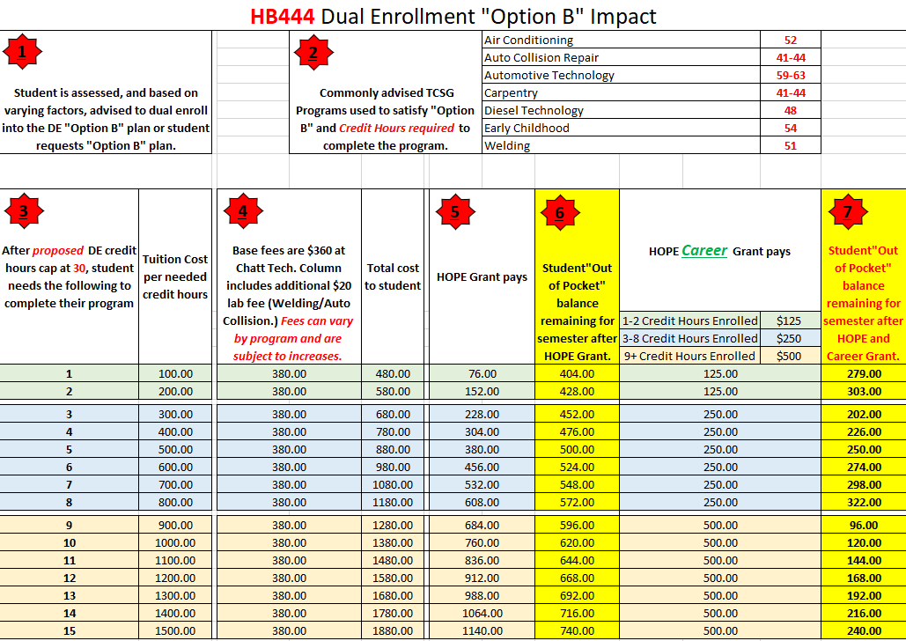

Slide 22
Dual Enrollment 2020-21
Satisfactory Academic Progress
A student must maintain Satisfactory Academic Progress (SAP), as defined and certified by his or her Eligible Postsecondary Institution.
  Students must maintain a minimum cumulative GPA of 2.0. The cumulative grade point average will be used to determine academic standing for financial aid.
  Students must complete and pass (earn) 67% of all courses attempted.
  If your program of study requires 30 credit hours to complete, once you have attempted 45 credit hours, you are no longer considered to be making Satisfactory Academic Progress and will not be eligible for a Warning period. Financial aid is automatically suspended.
Applied to all Dual Enrolled students!

Slide 23
Dual Enrollment 2020-21
Can a student retake or withdraw from a Dual Enrollment course?
Effective Summer term 2020 (FY2021), a student may not receive funding for the same course twice. Courses cannot be retaken and receive funding.
If a student Pursuing Option B fails a class needed to meet graduation requirements, that student would have to pay to retake the class. Failure to do so would prevent a student from graduating.
• Effective Summer term 2020 (FY2021), a student becomes ineligible to continue to receive funding from the program after their 2nd withdrawal.

Slide 24
Dual Enrollment 2020-21
Is there consideration for extenuating circumstances with withdrawals or retaking a course?
GSFC will draft standards for the types of extenuating circumstances that will be considered and will present those to the GSFC Board of Commissioners, but it is expected that such circumstances might include circumstances related to a serious illness or injury or death of an immediate family member during the term of the withdrawal or attempt of course to be retaken.
• A student may submit an Extenuating Circumstance Appeal Request with supporting documentation and approval from the high school and postsecondary institution.
• Appeals do not extend or add additional hours of funding. The 30 semester hour funding cap still applies.

Slide 25
Dual Enrollment 2020-21
x
Testing Exempt for Spring, Summer and FALL 2021 at CTC
Technical College System of Georgia (TCSG) Admission scores Requirements
Students wishing to dual enroll into a TCSG college, such as Chattahoochee Technical College, will have to present qualifying scores in one of the following:
  Accuplacer:
    Accuplacer is a product of College Board used nationwide for college admissions. The exam is a web based, multiple-choice, untimed assessment in English, reading, and mathematics subject areas. Scores are made available immediately.
  SAT scores
  ACT scores
  PSAT scores - NOTE: CTC only accepts the PSAT 10 and the and PSAT/NMSQT version of the test. CTC does not accept the PSAT 8/9. Student score report should clearly mark the version of the PSAT.
  High School GPA - High school HOPE GPA of > 2.6 (after completion of 10th grade) will place students into program-level ENGL/MATH and courses with “program admission” prerequisites.
There is no fee to take the exam (one time) for students interested in the Dual Enrollment Program.

Slide 26
Dual Enrollment 2020-21
The University System of Georgia (USG) will waive test score requirements for Spring, Summer and Fall 2021 admission due to uncertainty about the scheduling of SAT/ACT testing during the COVID-19 pandemic.
Students must still meet all other admission requirements, and adjusted minimum grade point average.
x
University System of Ga. (USG) Admissions
All USG dual enrollment applicants must submit an official high school transcript showing they are on-track for completing their high school graduation requirements and the USG’s Required High School Curriculum as outlined on the Staying on Course document , a completed Student Participation Agreement, and official SAT or ACT scores (if required by the college or university). Students planning to take courses on the college or university campus must satisfy the immunization requirement.
Students must meet the dual enrollment admissions requirements set by the participating postsecondary institution they wish to attend. Each participating postsecondary institution sets its own admissions policies for high school dual enrollment students.
Some USG colleges accept Accuplacer scores as part of the Dual Enrollment admissions process.
University of Georgia - Participation is limited to residents of the following counties surrounding the greater Athens area: Banks, Barrow, Clarke, Elbert, Franklin, Greene, Hart, Jackson, Madison, Morgan, Oconee, Oglethorpe, Stephens, and Walton.

Slide 27
Dual Enrollment 2020-21
Dual Enrollment Grade Reporting
All grades from colleges and universities will be reported as A, B, C, or F. These letter grades will be entered into our transcript file at Pickens High School as 95, 85, 75 & 65.
D’s will be recorded as a 70 if it is accepted as a passing grade from the college. If a D is not passing it will be recorded as a 65. Some colleges will accept a “D” as passing, but the class may not be eligible to transfer.
College academic classes that are successfully completed will receive a 10% weight on student’s high school transcript.

Slide 28
Dual Enrollment 2020-21
How to “Get Started” in the Dual Enrollment Program
Attend one of the Dual Enrollment Information live sessions, or watch the Dual Enrollment Information PowerPoint located on the PHS website.
Visit, or email Mr. Bell or your counselor to express your interest in the Dual Enrollment Program.
  We will audit your transcript, as well as your graduation plan, and make recommendations for course selections.
Parent/guardian must fill out and agree to the terms of the Student Advisement Plan only after attending/watching the Dual Enrollment Information PowerPoint.
Follow directions in the Dual Enrollment (DE) Student Checklist FY 2021: located on the PHS website → Counseling Tab→ Dual Enrollment
PHS is working toward having all Dual Enrollment information and “How to” documents located on the PHS website. However, any student/parent who wants to meet with Mr. Bell and/or the student’s counselor will be accommodated.

Slide 29
Dual Enrollment 2020-21
How to “Get Started” in the Dual Enrollment Program
At the completion of Step 3 of the PHS “Get Started” requirements, you will then follow the directions of the participating college to complete your admissions process. If accepted, You become a college student and are required to attend a New Student Orientation (NSO).
PHS will provide support and guidance, but the participating college’s policies and procedures apply.
Communications become between the Dual Enrolled student and the participating college via personal email and college email.
    Monitoring the communication platforms are critical to the success of the dual enrolled student.
Student must follow the college calendar, which differs from the Pickens County Schools calendar.

Slide 30
Dual Enrollment 2020-21
Dual Enrollment Points of Interest
The Dual Enrollment dual-credit program is not available for coursework exempted or given credit by examination, testing, training, or prior experience.
Withdrawing from a course or not following program rules and regulations may result in students losing credit, receiving a failing grade and/or being removed from Dual Enrollment; thus, affecting their high school graduation requirements.
Students must make annual progress towards graduation and completion of their Individual Graduation Plan to participate in the Dual Enrollment dual-credit program.
All approved Dual Enrollment mathematics courses provide options for meeting the fourth course beyond the Advanced Algebra/Algebra II graduation requirement.
Neither College Algebra nor any other college course has been approved as an equivalent of Algebra II/Advanced Algebra.

Slide 31
Dual Enrollment 2020-21
Dual Enrollment Points of Interest
Eligible post- secondary institutions have the authority to implement institutional policies of admission acceptance and course offerings for dual enrollment student participation.
A student may enroll at two or more Eligible Postsecondary Institutions during a single term. An Eligible Dual Enrollment student cannot receive Dual Enrollment funding for hours which exceed the 15 semester or 12 quarter hours per term limit, regardless of the number of Eligible Postsecondary Institutions in which the student is Enrolled.
Eligible post-secondary institutions must provide (LOAN) textbooks required for the courses taken through the Dual Enrollment Program at no cost to the student.
    Includes access code if course is delivered online.
The eligible post-secondary institution is permitted to charge a dual enrolled student a fine for a lost or damaged book which was loaned to the student. The student may be charged the lesser of: The cost of the book minus the Dual Enrollment book allowance for the specific course or $75.00.

Slide 32
Dual Enrollment 2020-21
Dual Enrollment Points of Interest
Students must have approval by their PHS counselor to make changes to their college schedule…no exceptions.
    This includes drops/adds or withdrawals.
Student’s college grades cannot be seen by PHS until a report is submitted from the college at mid term.
    It is extremely important for parents/ guardians to monitor their student’s academic progress.

Slide 33

Dual Enrollment 2020 - 2021
Notes from Chattahoochee Technical College
Testing Exempt for Spring, Summer and FALL 2021!!!:
Fall will be exempt for DE and General Admissions Students .
Jr's and Sr's can enter with no testing
Sophomores looking to take technical classes like Welding, HAVAC, ....etc. will NOT be required to test.
Sophomores wanting to take degree level core ENGL 1101, MATH 111...etc. will follow the DE legislation requirement for Zell Miller SAT/ACT.
DE Virtual Session: Oct 7th, 4pm and 7pm
Sign up Genius Link: CTC Dual Enrollment Session-Pickens Click Link to Sign up
Instagram live: askjamie2020
Jamie King is a CTC rep who holds live events on Instagram every other Thursday to answers questions about college.
Added Notes for DE:
We will continue to require an advisement plan for admission into the college. Make sure the student has a copy to submit to the college.

Slide 34
Dual Enrollment 2020 - 2021
Notes from Chattahoochee Technical College cont.
Dual Enrollment Document Deadline:
Semester Application Deadline * Document Deadline
Spring 2021: January – May 2021 (November 1, 2020 November 15, 2020)
Summer 2021: June – July 2021 (March 1, 2021 March 15, 2021)
Fall 2021: August – December 2021 (May 1, 2021 May 15, 2021)
Senior Session: Oct 29, 4pm and 7pm
This session will highlight our apply to college week Nov 9th - 13th. (This will be great for any December Grads.)
Sign up Genius Link: I will send closer to the date.
General Admissions Priority Deadline:
Spring Semester 2021: (January 11 – May 8) Priority Deadline: November 20, 2020
Summer Semester 2021: (June 5 – July 31) Priority Deadline: May 14, 2021
Fall Semester 2021: TBA
Instagram live: askjamie2020
Jamie King is a CTC rep who holds live events on Instagram every other Thursday to answers questions about college.

Slide 35
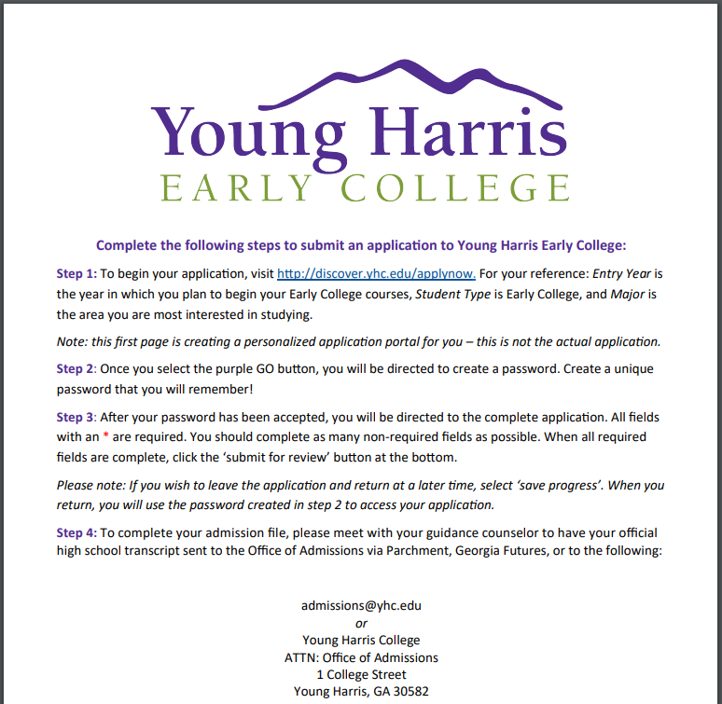

Dual Enrollment 2020 - 2021
Our minimum GPA requirement for admission is a 3.0 academic GPA (calculated using only math, English/language arts, history, science, and foreign language courses).

Slide 36
Dual Enrollment 2020 - 2021
Notes from Young Harris College
Talk with your guidance counselor about your interest in the dual-enrollment program offered by Young Harris Early College.
Submit your application for admission at discover.yhc.edu/applynow. Submit the initial inquiry form, set your password, and complete the application! If you have questions about the application process, contact YHC Admissions at (706) 379-3111.
Submit an official copy of your high school transcript with your most recent grades. If you have test scores, submit your official SAT or ACT scores. If you have not taken the SAT or ACT yet, you may still be eligible to participate in the program if you have a 3.2 GPA.
Visit GaFutures.org to complete your Dual Enrollment funding application by clicking on the 'apply now' button.
After you receive your acceptance email from YHC, visit your Young Harris College application portal to find your login and other important information.
Access your YHC account information on your application portal approximately 30 days before your course(s) begin, and visit email.yhc.edu to access your new email.

Slide 37

Dual Enrollment 2020 - 2021
Notes from University of North Georgia
COVID-19 2021 Dual Enrollment Admissions Changes
Must be a rising high school junior or senior at time of enrollment.
GPA remains at 3.25 as calculated on completed Required High School Curriculum (RHSC).
Application Deadlines: Spring/Nov. 1st Summer/April 15th Fall/May 15th
For more information, please contact:
Lori Bramlett, Assistant Director for Enrollment Services at 706-946-5462 or lori.bramlett@ung.edu
ACT Scores 20 English or Reading 18 Math 20 Composite | SAT Scores 530 EBRW 480 Math 1050 Combined
PSAT Scores 490 EBRW 440 Math 960 Combined | Accuplacer Scores 243 Reading 4 Writeplacer 266 Math
PreACT Scores 20 English or Reading 18 Math 20 Composite

Slide 38

Dual Enrollment 2020 - 2021
Notes from Kennesaw State University
Admission Requirements:
Must be considered a high school Junior or Senior
3.0 as calculated by KSU
2 units of English, Math (completion of Algebra II prior to the start of the term), Science, and 1 unit of Social Science
SAT and/or ACT is not required for spring, summer, or fall 2021 terms
Policy Statement
New Student form
DE decisions are made on a rolling basis
Students interested in Kennesaw State's dual enrollment program can learn more information on our dual enrollment website at dep.kennesaw.edu.

Slide 39
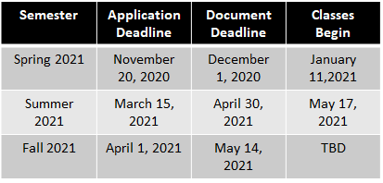
Dual Enrollment 2020 - 2021
Notes from Kennesaw State University

Slide 40
Dual Enrollment 2020 - 2021
Notes from Kennesaw State University
Information sessions: Register for the events on our dual enrollment website, dep.kennesaw.edu
Date | Time
Monday, October 5, 2020 | 6pm-7pm
Wednesday, October, 14, 2020 | 2pm-3pm
Wednesday, November 18, 2020 | 6pm-7pm

Slide 41

Dual Enrollment 2020 - 2021
Notes from Reinhardt University
Contact Liz Rowland at 770-720-5958 or Liz.Rowland@reinhardt.edu for more information
Student Eligibility for Dual Enrollment
To be eligible for the dual enrollment program, a student must:
Be enrolled in the 11th or 12th grade of a private or public high school in Georgia or a home study program within the State of Georgia operated in accordance with O.C.G.A. §20-2- 690(c); and on track to graduate
Be admitted to Reinhardt University as a dual enrollment student;
Reinhardt University Dual Enrollment Admission requirements are as follows:
SAT or ACT test scores will no longer be required for dual enrollment applicants with a GPA of 3.5 or above in college preparatory courses for Fall 2021.
Completed Dual Enrollment Counselor Consent
Be enrolled in courses listed in the approved Dual Enrollment Course Directory
Maintain satisfactory academic progress and follow Reinhardt University Code of Conduct and Honor Pledge at all times as defined by the eligible postsecondary institution to remain eligible for the program

Slide 42
Dual Enrollment 2020 - 2021
Notes from Reinhardt University
Application Deadlines
To begin classes in the Fall 2021 semester, applicants are required to submit their application (https://www.reinhardt.edu/admissions/steps-to-apply)
and all required documents prior to April 1, 2021. All completed applications will be reviewed after this deadline. Students will be notified of their selection.
View the Reinhardt University dual enrollment-approved course directory
https://apps.gsfc.org/secure/dsp_accel_course_listings.cfm

Slide 43
Dual Enrollment 2020 - 2021
Notes from Reinhardt University
How to Apply as a Dual Enrollment Student
Complete an online application. Select Dual Enrollment on page 3 under Enrollment Classification.
Submit an official high school transcript showing that you have earned at least a 3.50 gradepoint average in college preparatory classes.
Submit the Dual Enrollment Counselor Consent Form. You and your high school counselor can see your class options here.
Dual enrollment students are allowed to enroll for a maximum of four (4) semesters. Admission decisions are not based on religion, race, creed, color, gender, marital status, or national origin. Admission to Reinhardt University does not guarantee admission to a specific program, such as teacher education or music. See individual degree programs for admission requirements.

Slide 44
Dual Enrollment 2020-21
If you have any questions, please contact Daniel Bell at the information below:
Daniel Bell
danielbell@pickenscountyschools.org
Pickens County Schools College and Career Coach
(706)-253-1800 ext. 132

